Slide 1
Imperatives for a Fresh Approach to Monitor & Analyze Change
By Vinh Nguyen

Slide 2
Impending Challenges
Aggressive Digitalization of the Bank’s services
Increased Reliance on Cloud Services
Increased Scrutiny from Regulators
Competitive Labor Market
Changes to the Bank’s Information Assets will happen at a higher frequency
The majority of changes with high impact to the Bank will come from outside of the Bank
More frequent changes with higher impact will raise the Bank’s risk posture
A Fresh Approach to Monitor, Analyze and Govern Changes is required

Slide 3
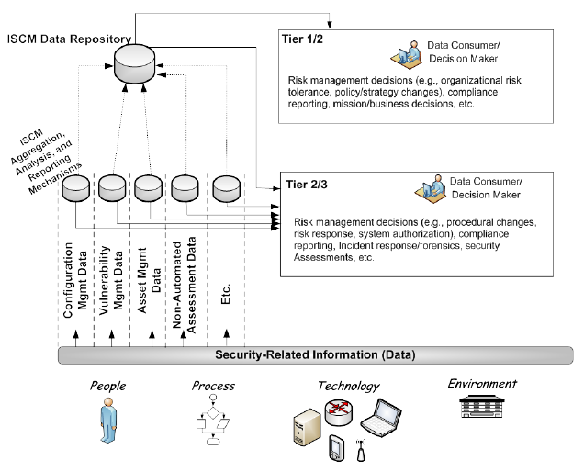
A New Approach: Three-tiered Monitoring
Determine impact of change on the Bank’s risk posture
Determine risk mitigation approaches according to the Bank’s risk tolerance
Analyze the nature and scope of changes on the core mission and business processes at the Bank
Collect data from all nodes in the Bank’s information systems
Design metrics to present information in a context that is meaningful for each tier
Source: NIST Special Publication 800-137
Figure D-2. Sample ISCM Implementation

Slide 4
Our Proposal
Define the desired state of the future monitoring approach
Assess the current state
Finalize a plan to get to the desired state
Investigate the currently available technical solutions
Perform a Proof-of Concept to serve as the Prototype for the new monitoring approach

Slide 5
Q&A
How can changes possibly impact our Bank’s risk posture?
Why does the Bank need to monitor the new changes that come from our strategy of digitalization?
What changes can the Bank expect because of our plan to rely on the services from the cloud?
Why would regulators scrutiny the Bank’s way to monitor changes?

